Slide 1


Multimedia Authoring

Slide 2
refers to the process of creating multimedia content using various tools, techniques, and technologies
What is Multimedia Authoring?
involves the integration of different media types such as text, images, audio, video, animations, and interactive elements to deliver an engaging and interactive user experience

Slide 3

Multimedia authoring tools
gives an integrated environment for joining together the different elements of a multimedia production.
software applications that allow users to create interactive multimedia presentations, applications, or content without extensive programming knowledge.
gives the framework for organizing and editing the components of a multimedia project.
enables the developer to create interactive presentation by combining text, audio, video, graphics and animation.

Slide 4
The process of multimedia authoring typically involves several key steps:
Planning and Conceptualization
Content Creation
Storyboarding
Multimedia Authoring Tool Selection
Development and Integration
Testing and Iteration
Deployment and Distribution
Maintenance and Updates

Slide 5
The process of multimedia authoring typically involves several key steps:
Planning and Conceptualization:
Content Creation:
defining the objectives of the multimedia project
identifying the target audience
and brainstorming ideas for the content and interactive elements.
developing or gathering the various media elements that will be used in the multimedia project
Content may be created using software tools
Notes:
like Adobe Creative Suite (e.g., Photoshop, Illustrator, Premiere Pro, After Effects), or obtained from external sources such as stock media libraries.

Slide 6
The process of multimedia authoring typically involves several key steps:
Storyboarding
Multimedia Authoring Tool Selection
process of creating a visual outline or blueprint of the multimedia project,
illustrating the sequence of content and interactions.
help to plan the layout, navigation, and flow of the multimedia presentation or application
choose the appropriate multimedia authoring tool based on the project requirements, budget, and the skill level of the team.
Notes:
This could involve using specialized software such as Adobe Animate, Articulate Storyline, or H5P, among others.

Slide 7
The process of multimedia authoring typically involves several key steps:
Development and Integration
Testing and Iteration
Using the selected authoring tool, develop and integrate the multimedia elements into the project.
This may involve arranging the content, adding transitions, animations, and interactive features, and ensuring compatibility across different devices and platforms.
it's essential to test it thoroughly to identify any bugs, usability issues, or compatibility issues
help to refine and improve the project before its final release

Slide 8
The process of multimedia authoring typically involves several key steps:
Deployment and Distribution
Maintenance and Updates
deploy the multimedia project to its intended platform or distribution channels
involve publishing it on the web, distributing it via CD/DVD, or deploying it as a mobile app or interactive kiosk.
Regularly maintain and update the multimedia project to ensure its continued functionality and relevance.
This may involve fixing bugs, updating content, adding new features, or optimizing performance based on user feedback and changing technology trends.

Slide 9
Features of Authoring Tools
Editing Features
Organizing Features
Visual programming with icons or objects
Programming with a scripting language
Document Development tools
Interactivity Features
Simple branching
Conditional branching
Playback Features
Supporting CD-ROM or Laser Disc Sources
Supporting Video for Windows
Hypertext
Cross-Platform Capability
Run-time Player for Distribution
Internet Playability

Slide 10

Editing Features
Features of Authoring Tools
Most authoring environment and packages exhibit capabilities to create edit and transform different kinds of media that they support. For example, Macromedia Flash comes bundled with its own sound editor. This eliminates the need for buying dedicated software to edit sound data. So authoring systems include editing tools to create, edit and convert multimedia components such as animation and video clips.

Slide 11
Organizing Features
Features of Authoring Tools
The process of organization, design and production of multimedia involve navigation diagrams or storyboarding and flowcharting. Some of the authoring tools provide a system of visual flowcharting or overview facility to showcase your project's structure at a macro level. Navigation diagrams help to organize a project. Many web-authoring programs like Dreamweaver include tools that create helpful diagrams and links among the pages of a website.

Slide 12
Visual programming with icons or objects
Features of Authoring Tools
It is simplest and easiest authoring process. For example, if you want to play a sound then just clicks on its icon.

Slide 13
Programming with a scripting language
Features of Authoring Tools
Authoring software offers the ability to write scripts for software to build features that are not supported by the software itself. With script you can perform computational tasks - sense user input and respond, character creation, animation, launching other application and to control external multimedia devices.

Slide 14
Document Development tools
Features of Authoring Tools
Some authoring tools offers direct importing of pre-formatted text, to index facilities, to use complex text search mechanism and to use hypertext link-ing tools.

Slide 15
Interactivity Features
Features of Authoring Tools
Interactivity empowers the end users to control the content and flow of information of the project. Authoring tools may provide one or more levels of interactivity.

Slide 16
Simple branching
Features of Authoring Tools
Offers the ability to go to another section of the multimedia production.

Slide 17
Conditional branching
Features of Authoring Tools
Supports a go to base on the result of IF-THEN decision or events.

Slide 18
Playback Features
Features of Authoring Tools
When you are developing multimedia project, you will continouslly assembling elements and testing to see how the assembly looks and performs. Therefore authoring system should have playback facility.

Slide 19
Supporting CD-ROM or Laser Disc Sources
Features of Authoring Tools
This software allows over all control of CD-drives and Laser disc to integrate audio, video and computer files. CD-ROM drives, video and laserdisc sources are directly controlled by authoring programs.

Slide 20
Supporting Video for Windows
Features of Authoring Tools
Videos are the right media for your project which are stored on the hard disk. Authoring software has the ability to support more multimedia elements like video for windows.

Slide 21
Hypertext
Features of Authoring Tools
Hypertext capabilities can be used to link graphics, some animation and other text. The help system of window is an example of hypertext. Such systems are very useful when a large amount of textual information is to be represented or referenced.

Slide 22
Cross-Platform Capability
Features of Authoring Tools
Some authoring programs are available on several platforms and provide tools for transforming and converting files and programs from one to the other.

Slide 23
Run-time Player for Distribution
Features of Authoring Tools
Run time software is often included in authoring software to explain the distribution of your final product by packaging playback software with content. Some advanced authoring programs provide special packaging and run-time distribution for use with devices such as CD-ROM.

Slide 24
Internet Playability
Features of Authoring Tools
Due to Web has become a significant delivery medium for multimedia, authoring systems typically provide a means to convert their output so that it can be delivered within the context of HTML or DHTML.

Slide 25
Authoring Tools Classification
Card or Page based authoring tools
Icon based or Event driven authoring tools
Time based authoring tools
Object-Oriented authoring tools
Web page authoring tools

Slide 26
Card or Page based authoring tools
elements are organized as pages of a book or a stack of cards
In the book or stack there are thousands of pages or cards available.
These tools are best used when the bulk of your content consists of elements that can be viewed individually
Example, the pages of a book or file cards in card file. You can jump from page to page because all pages can be interrelated.
In the authoring system you can organize pages or cards in the sequences manner.
Every page of the book may contain many media elements like sounds, videos and animations.

Slide 27
Card or Page based authoring tools
One page may have a hyperlink to another page that comes at a much later stage and by clicking on the same you might have effectively skipped several pages in between.
Some examples of card or page tools are:
Hypercard (Mac)
Tool book (Windows)
PowerPoint (Windows)
Supercard (Mac)

Slide 28
Card or Page based authoring tools
Advantages
Easy to understand.
One screen is equal to 1card or 1page.
Easy to use as these tools provide template.
Short development time.

Slide 29
Card or Page based authoring tools
Disadvantages
Some run only on one platform.
Tools not as powerful as equivalent stand alone.

Slide 30
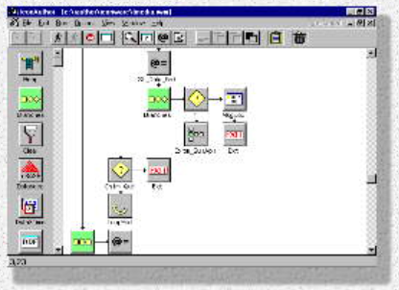
Icon based or Event driven authoring tools
Icon Author
Icon-based tools give a visual programming approach to organizing and presenting multimedia.
First you build a structure or flowchart of events, tasks and decisions by dragging appropriate icons from a library.
Each icon does a specific task, for example- plays a sound, open an image etc.
The flowchart graphically displays the project's logic.
When the structure is built you can add your content text, graphics, animation, video movies and sounds.
A nontechnical multimedia author can also build sophisticated applications without scripting using icon based authoring tools.
Some examples of icon based tools are:
Authorware Professional (Mac/Windows)
Icon Author (Windows)
Notes:
Icon Author is a graphical scripting language primarily designed for the creation of multimedia applications released by the computer software company Aimtech. Although not as well known, it is very similar to Macromedia's Director and Authorware in both it's abilities and usage.

Slide 31
Icon based or Event driven authoring tools
Advantages:
Clear Structure
Easy editing and updating
Disadvantages:
Difficult to learn
Expensive

Slide 32
Time based authoring tools
allow the designer to arrange various elements and events of the multimedia project along a well-defined timeline.
By timeline, we simply mean the passage of time.
As the time advances from starting point of the project, the events begin to occur, one after another.
The events may include media files playback as well as transition from one portion of the project to another.
The speed at which these transitions occur can also be accurately controlled.
These tools are best to use for those projects, wherein the information flow can be directed from beginning to end much like the movies.
Some example of Time-based tools are:
Macromedia's Director
Macromedia Flash

Slide 33
Time based authoring tools
Advantages
Good for creating animation.
Branching, user control, interactivity facilities.
Disadvantages
Expensive
Large file size
Steep learning curve to understand various features

Slide 34
Object-Oriented authoring tools
Object oriented authoring tools support environment based on object. Each object has the following two characteristics:
State or Attributes - The state or attributes refers to the built in characteristics of an object.
For example, a color T.V has the following attributes:
Color receiver
Volume control
Picture control
128 channels
Remote control unit

Slide 35
Object-Oriented authoring tools
Behavior or Operations - The behavior or operations of an object refers to its action.
For example, a T.V can behave in any of the following manner at a given point of time:
Switched on
Switched off
Displays picture and sound from
A TV cable connection
A TV transmitter
A DVD
A VCR

Slide 36
Object-Oriented authoring tools
Multimedia elements events are often treated as objects that live in a hierarchical order of parent and child relationships.
These objects use messages passed among them to do things according to the properties assigned to them.
For example, a video object will likely have a duration property i.e how long the video plays and a source property that is the location of the video file.
This video object will likely accept commands from the system such as play and stop.
Some examples of the object oriented tools are:
mTropolis (Mac/Windows)
Apple Media Tool (Mac/Windows)
Media Forge (Windows)

Slide 37
Web page authoring tools
It allows users to create webpages.
Example software are the Adobe Dreamweaver and Front Page.
Advantages
1. Easy to use
2. Save time
Disadvantages
1. Limited Options
2. Reliance on the program

Slide 38
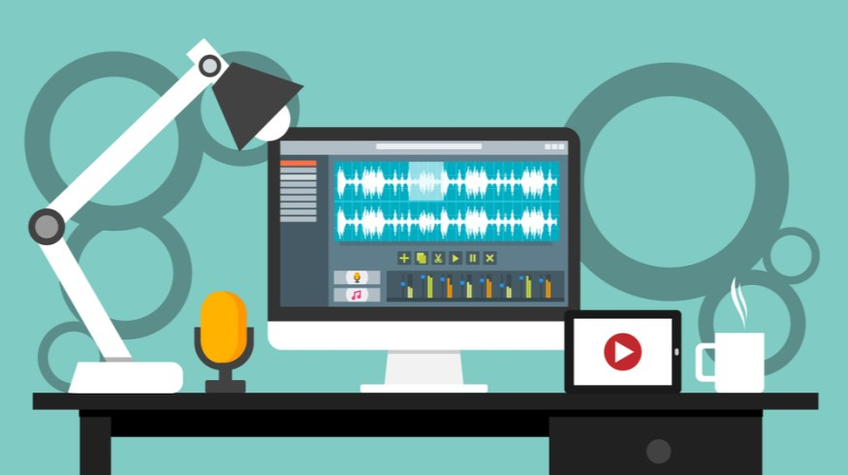
Audio
can be used to enhance multimedia applications in a number of ways, for example in delivering lectures over the web, music used to add interest and emotion to a presentation, and other non-speech audio used as part of a general interface.

Slide 39

Images
are a media type displayed as visual information. They can be drawings, paintings or photographs. Images are used to create interest and provide information. Photographs and other types of graphical data are designed specifically for display. An image on a screen is made up of dots called pixels

Slide 40
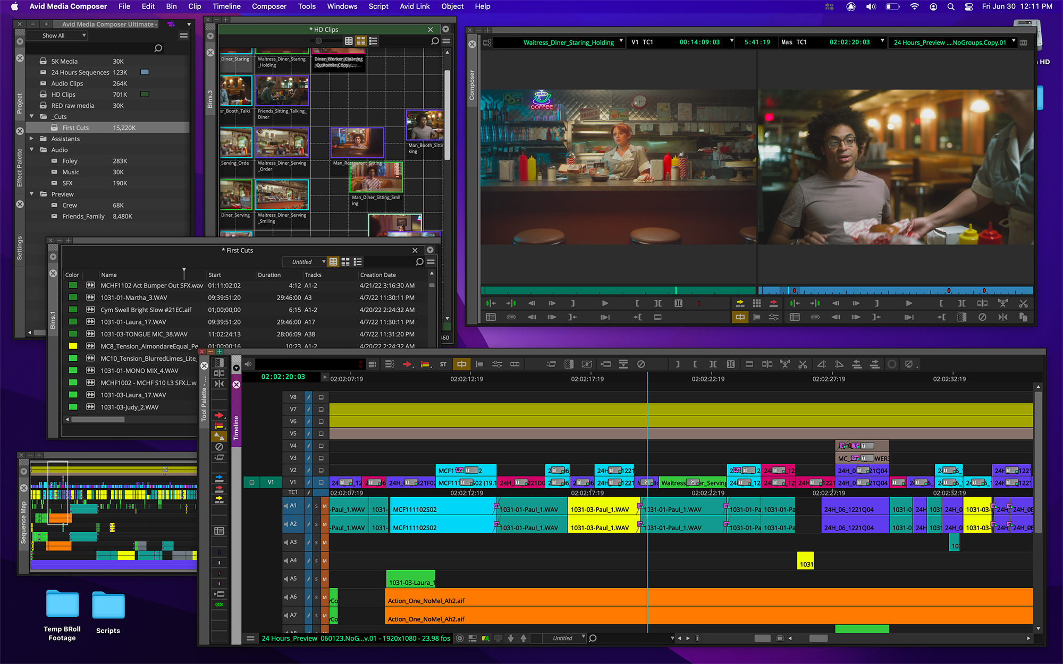
Video
refers to the moving picture, accompanied by sound such as a picture in television. Video elements of multimedia applications give a lot of information in a small duration of time. Digital video is useful in multimedia applications for showing real life objects.

Slide 41
Some popular multimedia authoring tools include:
Adobe Animate
Adobe Captivate
Articulate Storyline
Tumult Hype
Unity
Prezi
Microsoft PowerPoint
H5P

Slide 42
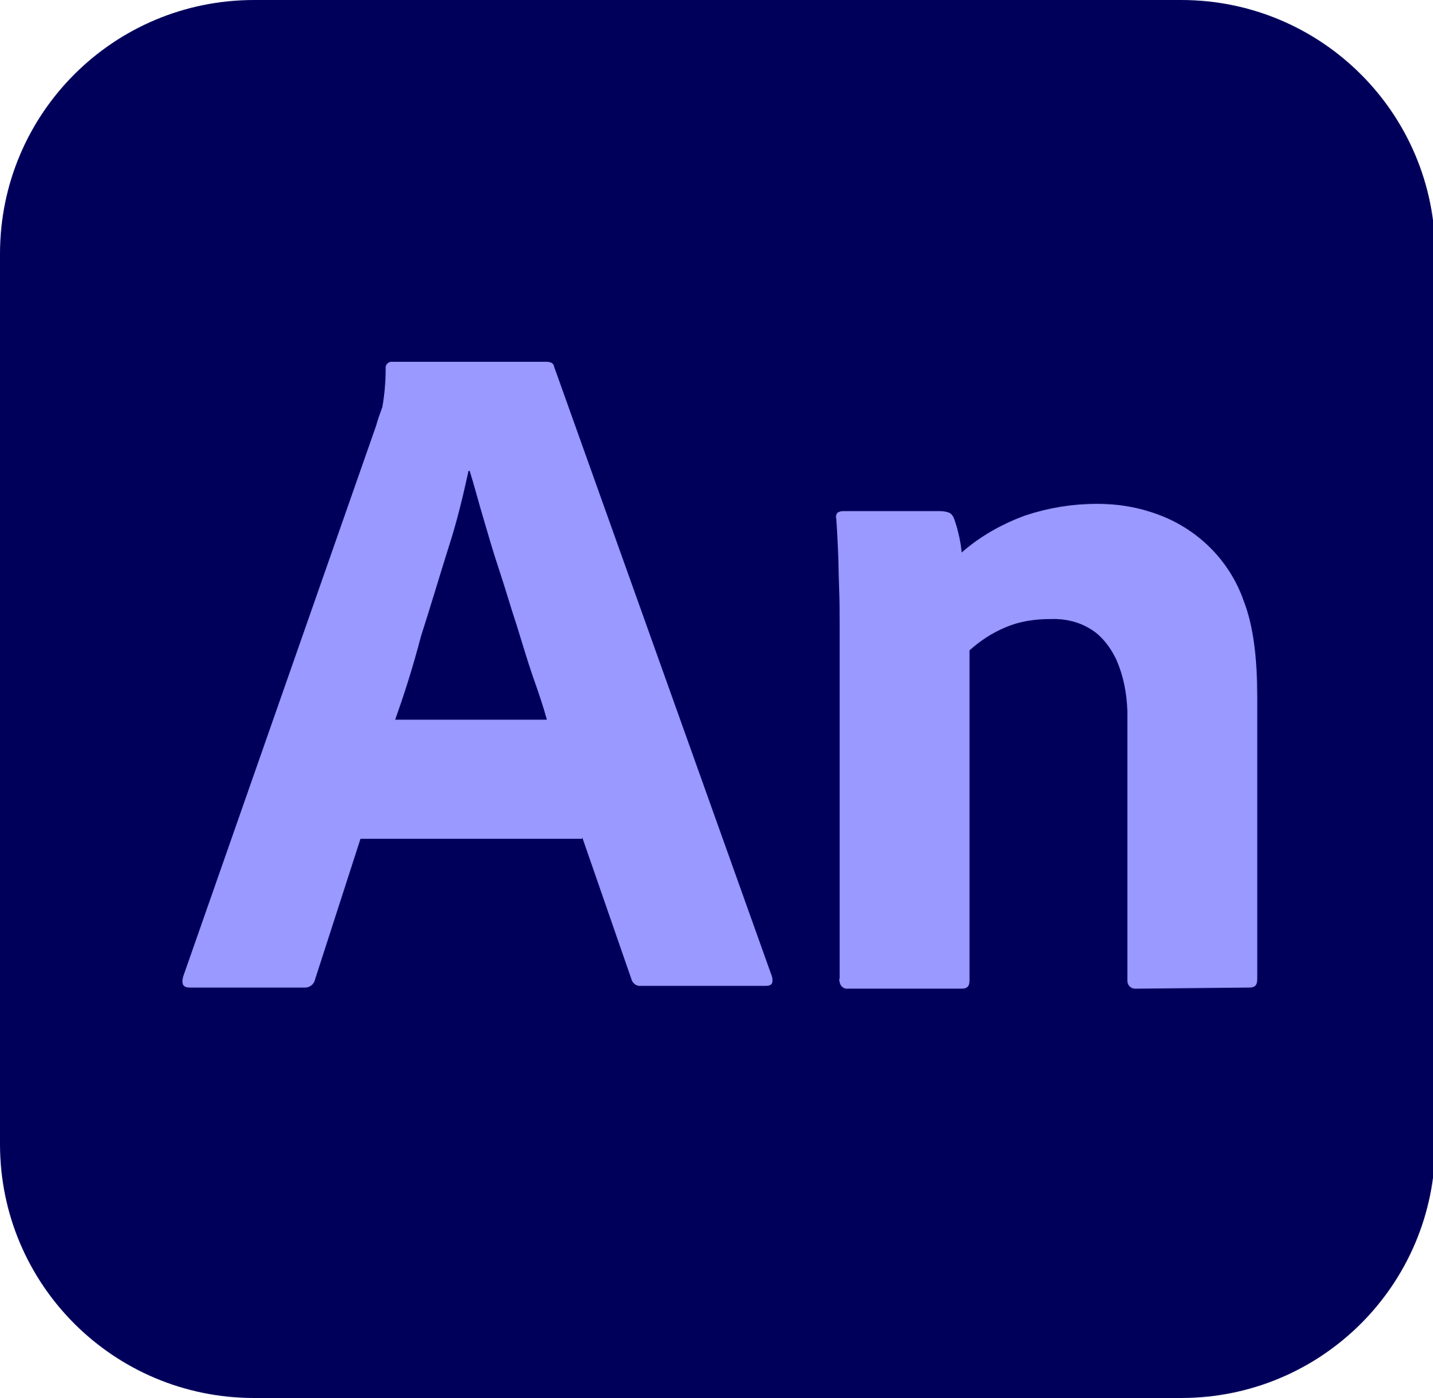
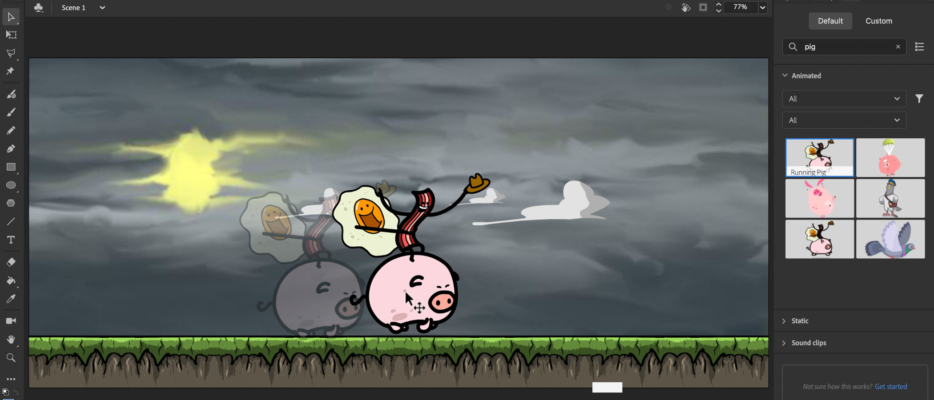
Adobe Animate
a multimedia authoring and computer animation program developed by Adobe. Animate is used to design vector graphics and animation for television series, online animation, websites, web applications, rich web applications, game development, commercials, and other interactive projects.

Slide 43
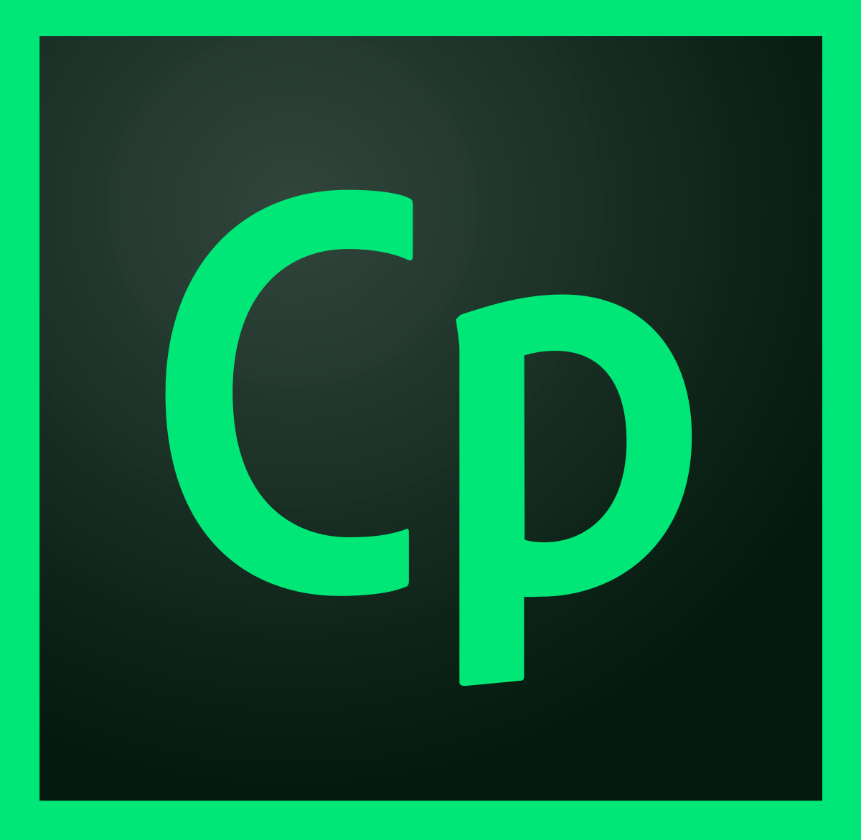
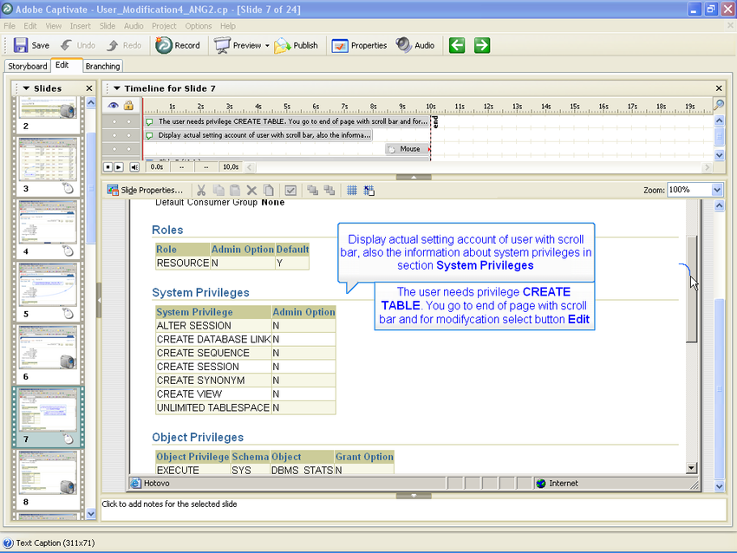
Adobe Captivate
an authoring tool that is used for creating eLearning content such as software demonstrations, software simulations, branched scenarios, and randomized quizzes in HTML5 format. For software simulations, Captivate can use left or right mouse clicks, key presses and rollover images.

Slide 44
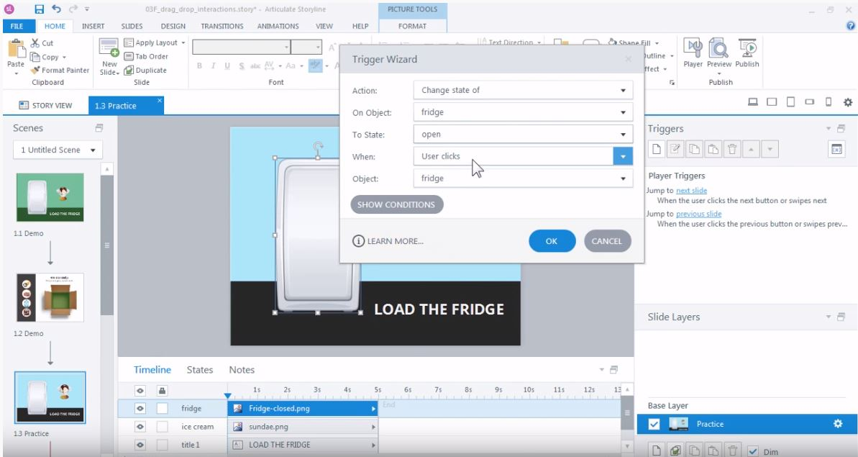
Articulate Storyline
Articulate Storyline 360 is a cloud-based platform that enables businesses to create interactive eLearning courses. With Articulate Storyline 360 tool, users can develop custom project templates/slides and save them in a central database for future use.

Slide 45
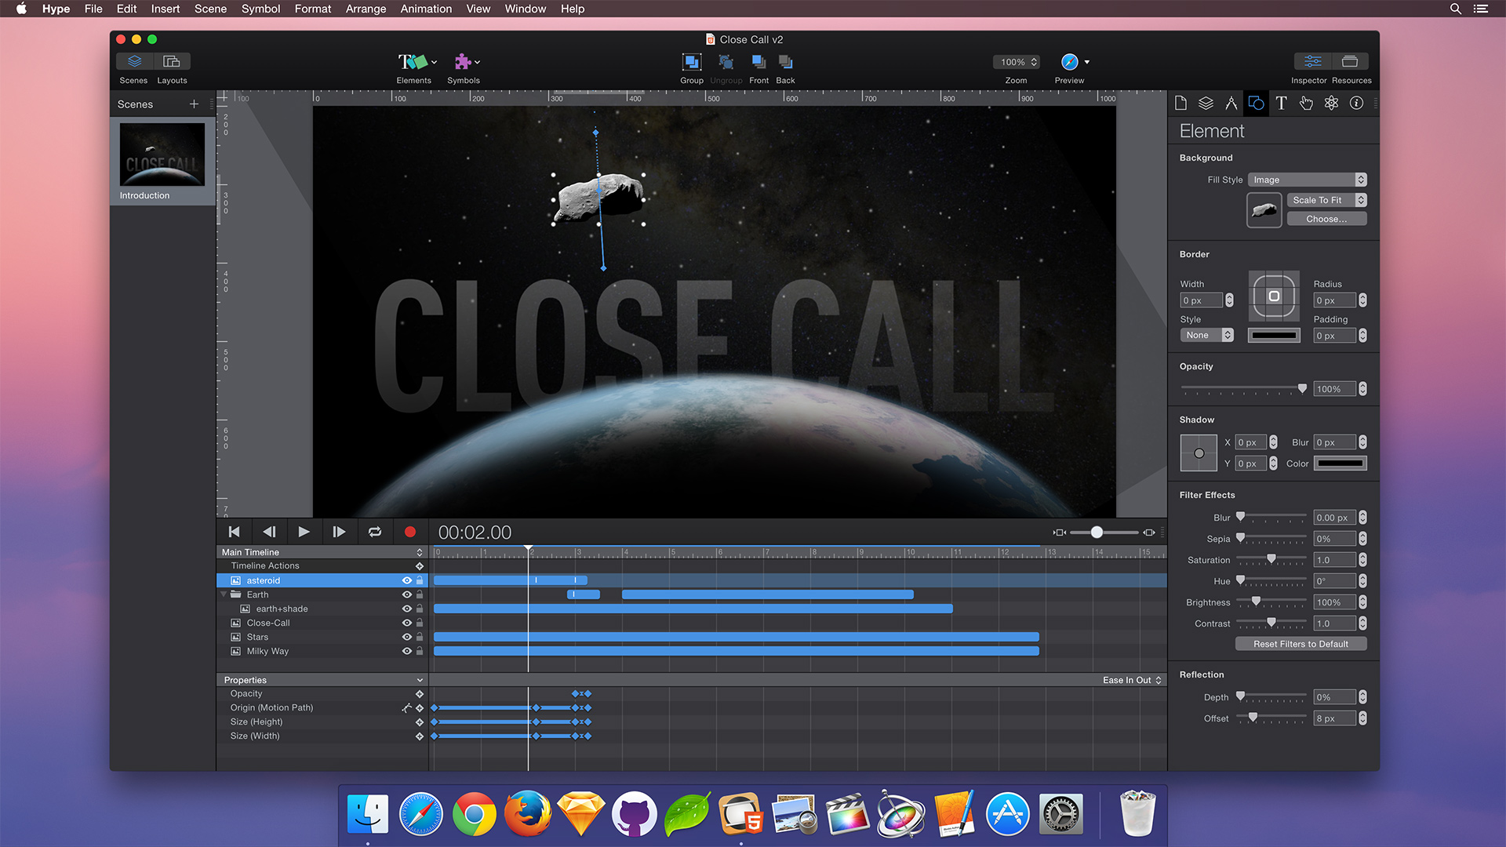
Tumult Hype
Tumult Hype is the HTML5 creation app for macOS. Animations and interactive content made with Tumult Hype work on desktops, smartphones and iPads.

Slide 46

Unity
Unity is a cross-platform game engine developed by Unity Technologies, first announced and released in June 2005 at Apple Worldwide Developers Conference as a Mac OS X game engine. The engine has since been gradually extended to support a variety of desktop, mobile, console and virtual reality platforms.
a licensed game engine used to create video games and other applications

Slide 47


Prezi is an American video and visual communications software company founded in 2009 in Hungary, with offices in San Francisco, Budapest and Riga as of 2020. According to Prezi, in 2021, the software company has more than 100 million users worldwide who have created approximately 400 million presentations.
Prezi is a web-based tool for creating presentations. It's similar to other presentation software—such as Microsoft PowerPoint—but it offers some unique features that make it a good alternative. It's also become increasingly popular in schools and businesses over the past several years.

Slide 48
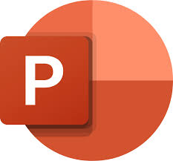
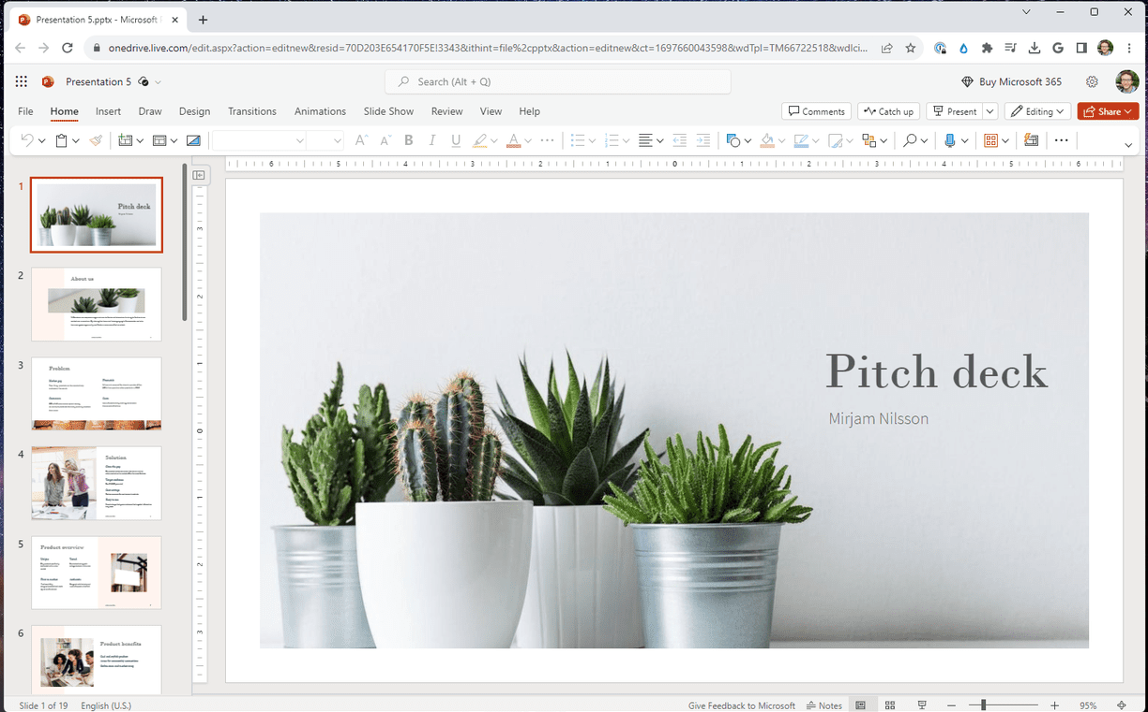
Microsoft PowerPoint
Microsoft PowerPoint is a presentation program, created by Robert Gaskins and Dennis Austin at a software company named Forethought, Inc. It was released on April 20, 1987, initially for Macintosh computers only. Microsoft acquired PowerPoint for about $14 million three months after it appeared.

Slide 49

H5P is a free and open-source content collaboration framework based on JavaScript. H5P is an abbreviation for HTML5 Package, and aims to make it easy for everyone to create, share and reuse interactive HTML5 content.
H5P enables existing CMSs and LMSs to create richer content. With H5P, authors may create and edit interactive videos, presentations, games, advertisements and more. Content may be imported and exported. All that is needed to view or edit H5P content is a web browser.

Slide 50
THANK YOU…

